Slide 1
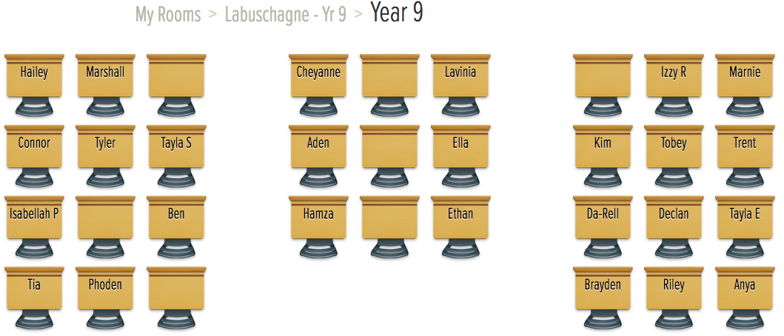

Slide 2
Finding A Rule
Year 9
Week 8
Lesson 1

Slide 3
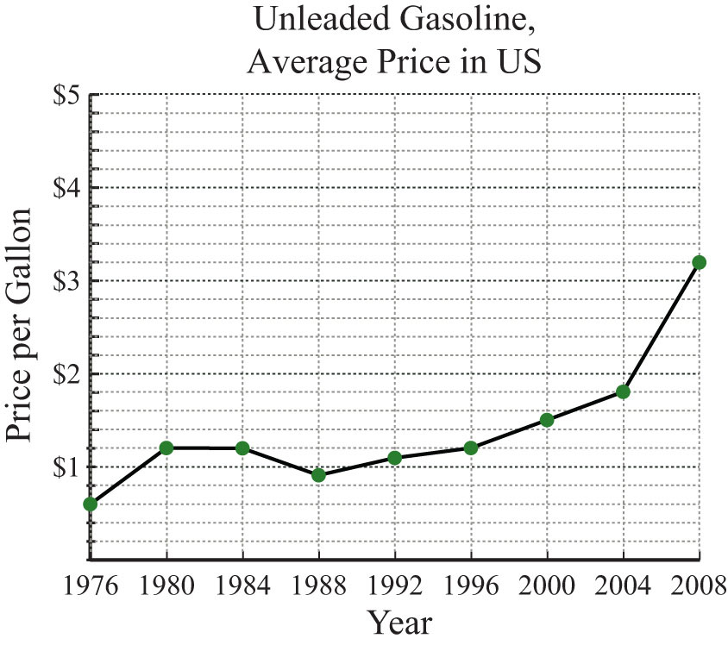

Beginning of the Lesson
What am I?
Notes:
• Link to past experiences or knowledge of the students
• Actively involve the students
• Relevant to the objective of the upcoming lesson

Slide 4

24
7
30
Topic: Finding a Rule
Date
EQ – How do you find the rule for a linear relationship?
What is a linear rule?
A linear rule increases by the same amount each step

Slide 5

24
7
30
Topic: Finding a Rule
Date
EQ – How do you find the rule for a linear relationship?
Count the number of matches or dots needed for each step. Write it in a table like the one down below:
Write the rule for the pattern (y = mx + c)
Check that the rule is correct
Step
Matches

Slide 6
24
7
30
Topic: Finding a Rule
Date
EQ – How do you find the rule for a linear relationship?
Count the number of matches or dots needed for each step.
Write the rule for the pattern (y = mx + c)
Check that the rule is correct
Step
Matches

Slide 7
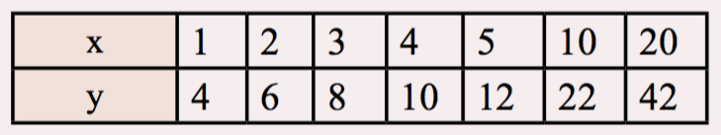
24
7
30
Topic: Finding a Rule
Date
EQ – How do you find the rule for a linear relationship?
Write the rule for the pattern (y = mx + c)
Check that the rule is correct

Slide 8
You need to higher an electrician to install new cables. So you have rung around to get some quotes from 3 different electricians.
quote 1 = $100 call out + $40 per hour
quote 2 = $150 call out and $35 per hour
quote 3 = $50 call out and $50 per hour
Which quote is cheapest?

Slide 9
24
7
30
Topic: Finding a Rule
Date
EQ – How do you find the rule for a linear relationship?
A linear relationship is one that increases by the same amount each time
A linear rule can be written in the format y = mx + c
eg. cost = $40 x hour + $100
Start by creating a table with hours on top and cost underneath
Hours | 0 | 1 | 2 | 3 | 4 | 5 | 6
Cost

Slide 10
24
7
30
Topic: Finding a Rule
Date
EQ – How do you find the rule for a linear relationship?
Try this with all 3.
Quote 1 cost = $40 x hours +$100
Quote 2 cost = $35 x hours + $150
Quote 3 cost = $50 x hours + $50
Hours | 0 | 1 | 2 | 3 | 4 | 5 | 6
Cost | 100 | 140 | 180 | 220 | 260 | 300 | 340
Hours | 0 | 1 | 2 | 3 | 4 | 5 | 6
Cost
Hours
Cost

Slide 11
How does all of this help?
You have now been told that there is 12 hours of work top be completed (it’s a major re-wire of several apartments). So which is cheapest?
Quote 1 cost = $40 x hours +$100
If hours = 12 then cost = $40 x 12 +$100
cost = $580
Quote 2 cost = $35 x hours + $150
If hours = 12 then cost = $35 x 12 +$150
cost = $570
Quote 3 cost = $50 x hours + $50
If hours = 12 then cost = $50 x 12 +$50
cost = $650

Slide 12
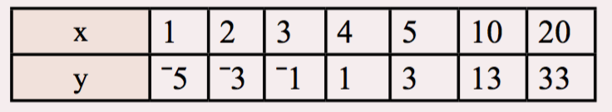
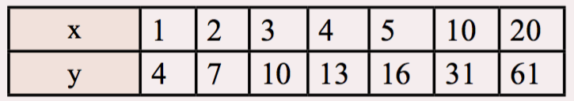
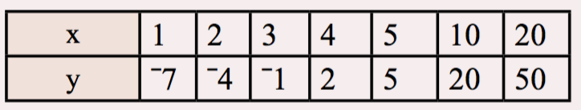
Task
Notes:
• Practise the skill
• Encouragement

